Slide 1
Module 06: Basic Probability

Slide 2
Overview
From the probability point of view, there are always 3 states.
1) Certainty: It could be an eternal event (like planets spinning around the sun etc.), a lifetime event (like me being born as Asian etc.), or a temporary event (I will be full if I eat two Costco hotdogs etc.)
2) Impossibility (a complete opposite to certainty): Similar as above, like the sun will never comes up from the west, I will never be smart or wealthy enough to travel in space, or I will never leave my raincoat home when it’s raining etc.
3) Uncertainty: Unfortunately or fortunately, most of the life events are in between the two above.
And that is the reason why life is beautiful! Because your action can make a difference in those probability values!

Slide 3

Ways to Get Probabilities
There are 3 ways to come up with probabilities.
1) Subjective Method: This is basically “made-up” facts, like I think 30% of Canadians support the Trudeau government or it is likely (~80% chance) that John will fall for the spam call.
2) Empirical Method: It is based on observations with the assumption that the pattern will continue, like when I throw a “thumbtack” 1,000 times, 287 of them will be “pin-down” or 35 out of my 140 students failed the Intro Stats course.
3) Theoretical Method: It is based on probability theory (more later) with the assumption that the theory or model will fit the data or the reality, like if you flip a fair coin 3 times, 12.5% (or 1 in 8) will be “3 heads”.

Slide 4
Probability – Basic Lingo/Jargons
An experiment is something that can be repeated (identically) with same set of (2 or more) outcomes.
Note: It does not mean you will get the same outcome each time. It just means the outcomes will come from a same set of many outcomes or possibilities.
Examples are flipping a coin, rolling a die, a 6/49 draw, the letter grade you will get in a course, ask if a Canadian would support the Trudeau govt, your reaction when you see a TikTok post etc.
The sample space is a collection of all possible outcomes, with all outcomes listed inside a “curly bracket” or “braces” like { }.
An event is collection of some (but usually not all) outcomes.

Slide 5
Theoretical Probability Examples
E.g.1: Experiment = tossing 1 fair coin all possible outcomes = H, T sample space = {H, T}
Note: events here aren’t very interesting… but
E.g.2: Experiment = tossing 3 fair coins all possible outcomes = HHH, HHT, HTH, THH, TTH, THT, HTT, TTT sample space = {HHH, HHT, HTH, THH, TTH, THT, HTT, TTT} event A = {all heads} = {HHH} event B = {at least 1 tail} = {HHT, HTH, THH, TTH, THT, HTT, TTT}
Imagine what would happen (a) when n = 3 becomes n = 1,000, or (b) when a fair coin (something we know very well) becomes a thumbtack (something we don’t)?
Notes:
Note: Please don’t get bogged down by the calculation here.
The purpose of these examples are to let you see that the number of possibilities (or outcomes) gets big rather quickly.

Slide 6
Empirical Probability Examples
E.g.1: Experiment = asking 1 Canadian if he/she supports the Trudeau govt. all possible outcomes = Yes, No, Maybe (if you allow it) sample space = {Yes, No} or {Yes, No, Maybe}
Again, it is not very interesting… but how about…
E.g.2: Experiment = asking 5 Canadians if they support the Trudeau govt. all possible outcomes and sample space (see below) event A = {more than 2 of them supporting Trudeau} event B = {at least 1 supporting Trudeau}
With Yes and No, there are 2⁵ = 32 of them = YYYYY, YYYYN, YYYNY, …, NNNNN. With Yes, No, Maybe, there are 3⁵ = 243 total outcomes
Imagine what would happen when (a) n = 5 becomes n = 1,000, or (b) 2 outcomes becomes 4 (representing 4 federal political parties)?
Notes:
Note: Please don’t get bogged down by the calculation here.
The purpose of these examples are to let you see that the number of possibilities (or outcomes) gets big rather quickly.

Slide 7
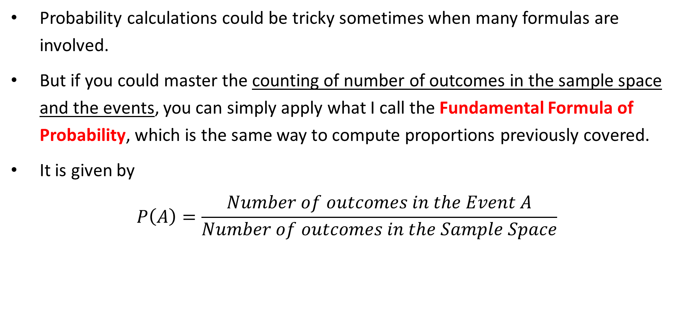
Fundamental Formula of Probability
Probability calculations could be tricky sometimes when many formulas are involved.
But if you could master the counting of number of outcomes in the sample space and the events, you can simply apply what I call the Fundamental Formula of Probability, which is the same way to compute proportions previously covered.
It is given by
$$P\left(A\right)=\frac{Number of outcomes in the Event A}{Number of outcomes in the Sample Space}$$

Slide 8
Some Uses of Probability 1
E.g. 1 (social life): A user has watched the entirety of a 5-second clip about topic 1 (say a cat playing with a dog), but only watched about 1 second of a 5-second clip about topic 2 (say about home renovation). As a machine, if the goal is to feed users something they like and to keep them on the app as long as possible. Which topic (1 or 2) would you feed him next?
E.g. 2 (health care): drug A has 80% survival rate and drug B has 92% survival rate for cancer patients. Which drug would you use to treat the next cancer patient?
What if drug b costs two times as much as drug a?
What about 10 times? 100 times?

Slide 9
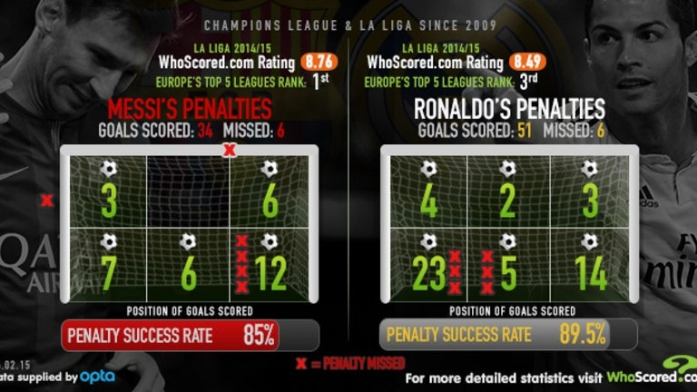
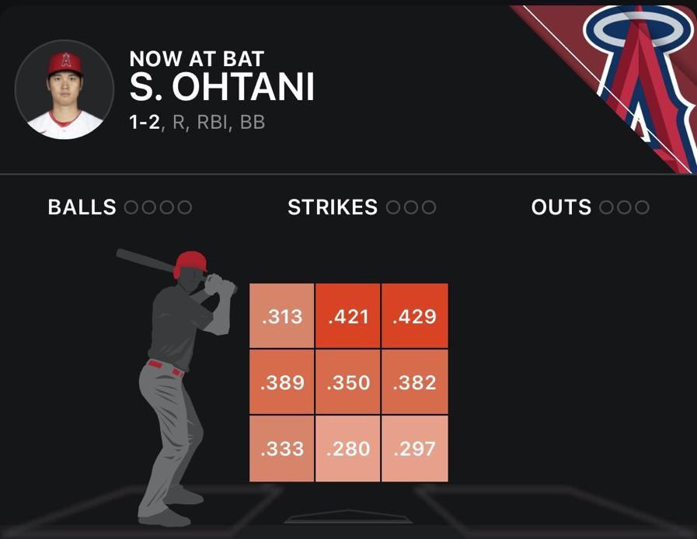
Some Uses of Probability 2
E.g. 3 (football/soccer): As an opposing goalkeeper, what is the best way to save the penalty shot from Messi or Ronaldo in a tie game at the 89th minute?
E.g. 4 (baseball): As an opposing pitcher, how would you pitch to Ohtani with a 3-2 count in a save situation?

Slide 10
Interpretation of Probability
E.g.1: Suppose Ronaldo has a penalty shot success rate of 90%. What does it mean? How can you explain this to a non-football person?
Answer A: Suppose he has scored 9 penalty shots in a row. The above number means that he will miss the 10th one for sure.
Answer B: Suppose he is going to kick the penalty infinite number of times (or many times in general), he is expected to score 90% of the time.
E.g.2: Suppose Shaquille O’Neal has a career free throw percentage of 50%. What does it mean to a non-basketball person?
Notes:
Eg1: B is the correct interpretation
Eg2: When Shaq is attempting infinite number of free throws, he is expected to make about 50% of them.

Slide 11
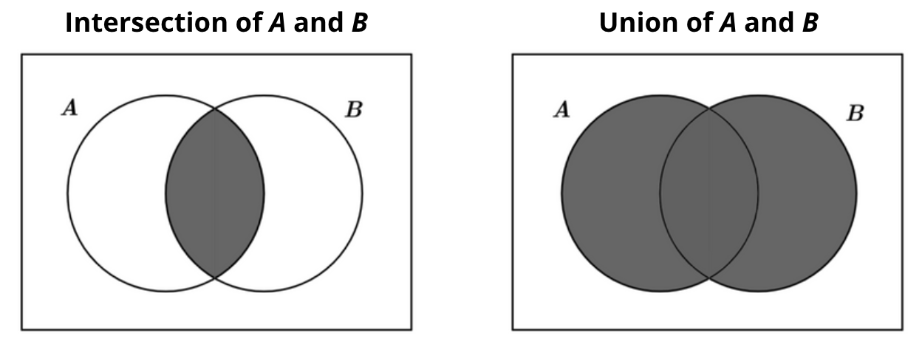
Intersection & Union
Intersection = AND → meeting both requirements
Union = OR → meeting one or both requirements

Slide 12
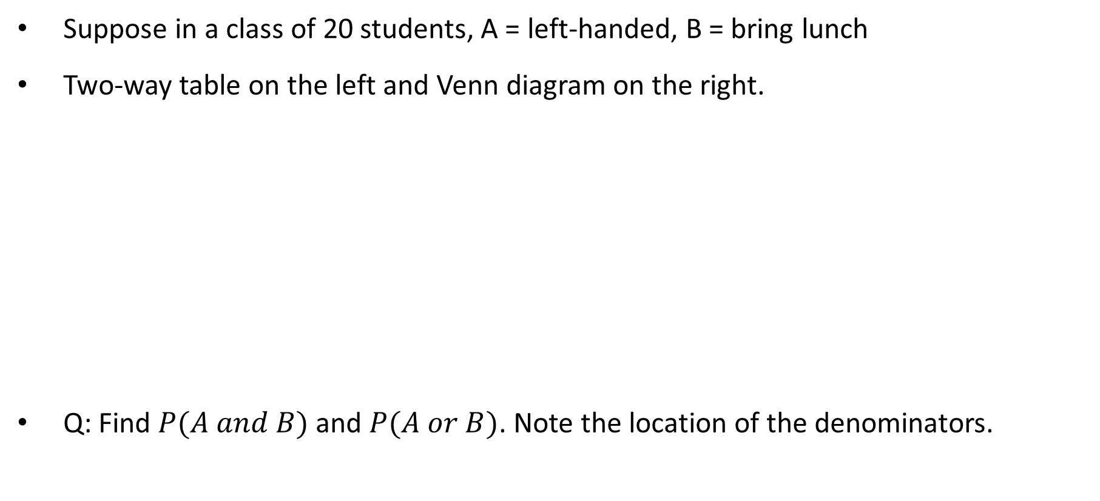
Examples
Suppose in a class of 20 students, A = left-handed, B = bring lunch
Two-way table on the left and Venn diagram on the right.
Q: Find $P(A and B)$ and $P(A or B)$. Note the location of the denominators.
 | Left-handed | Right-handed
Bring Lunch | 2 | 10
Buy Lunch | 3 | 5
Left-handed
Bring Lunch
3 2 10 5
Notes:
P(A and B) = 2/20
P(A or B) = (2 + 3 + 10)/20 = 15/20

Slide 13
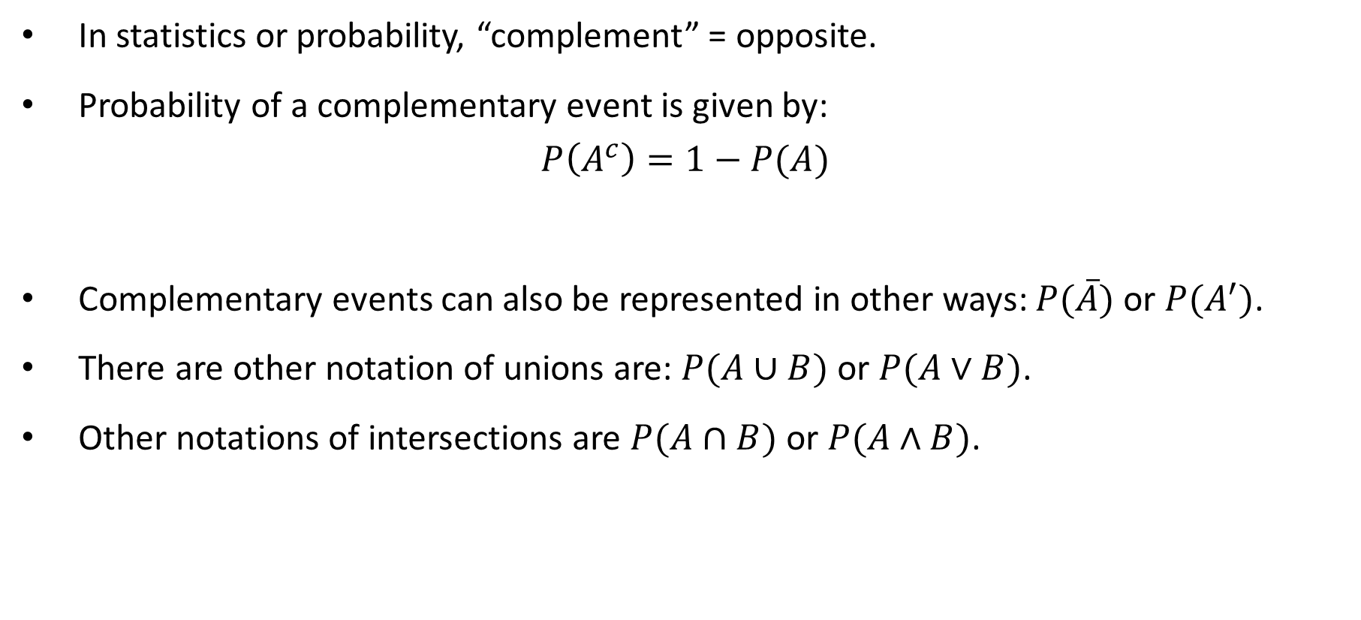
Complementary Events and Notations
In statistics or probability, “complement” = opposite.
Probability of a complementary event is given by:
$$P\left(A^{c}\right)=1−P(A)$$
Complementary events can also be represented in other ways: $P(\overline{A})$ or $P(A^{′})$.
There are other notation of unions are: $P(A∪B)$ or $P(A∨B)$.
Other notations of intersections are $P(A∩B)$ or $P(A∧B)$.

Slide 14
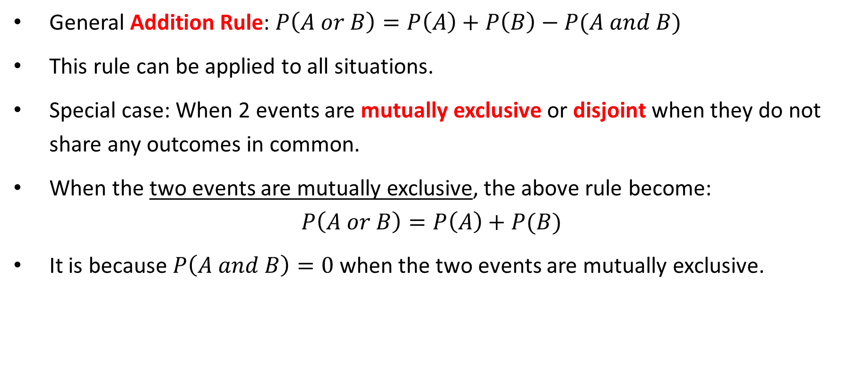
Disjoint Events and Addition Rule
General Addition Rule: $P\left(A or B\right)=P\left(A\right)+P\left(B\right)−P(A and B)$
This rule can be applied to all situations.
Special case: When 2 events are mutually exclusive or disjoint when they do not share any outcomes in common.
When the two events are mutually exclusive, the above rule become:
$$P\left(A or B\right)=P\left(A\right)+P(B)$$
It is because $P\left(A and B\right)=0$ when the two events are mutually exclusive.

Slide 15
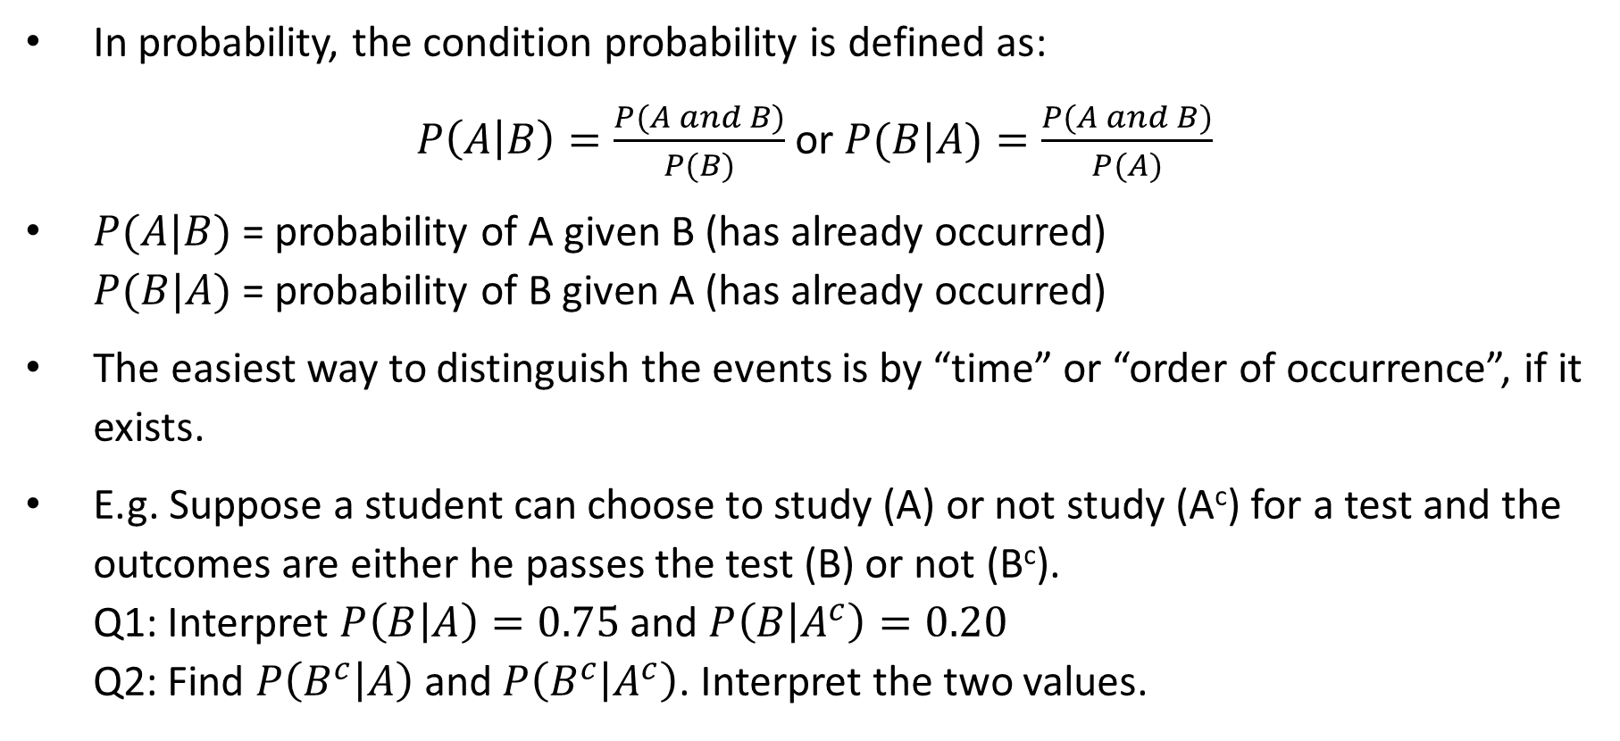
Conditional Probability
In probability, the condition probability is defined as:
$P\left(A | B\right)=\frac{P(A and B)}{P(B)}$ or $P(B|A)=\frac{P(A and B)}{P(A)}$
$P(A|B)$ = probability of A given B (has already occurred) $P(B|A)$ = probability of B given A (has already occurred)
The easiest way to distinguish the events is by “time” or “order of occurrence”, if it exists.
E.g. Suppose a student can choose to study (A) or not study (A^{c}) for a test and the outcomes are either he passes the test (B) or not (B^{c}). Q1: Interpret $P\left(B | A\right)=0.75$ and $P\left(B | A^{c}\right)=0.20$ Q2: Find $P\left(B^{c} | A\right)$ and $P\left(B^{c} | A^{c}\right)$. Interpret the two values.
Notes:
P(Bc|A) = 1 – P(B|A) = 1 – 0.75 = 0.25
When many students are taking this test, it’s expected 25% of the students who studied for the test will not pass.
P(Bc|Ac) = 1 – P(B|Ac) = 1 – 0.2 = 0.8
When many students are taking this test, it’s expected 80% of the students who did not study for the test will not pass.

Slide 16
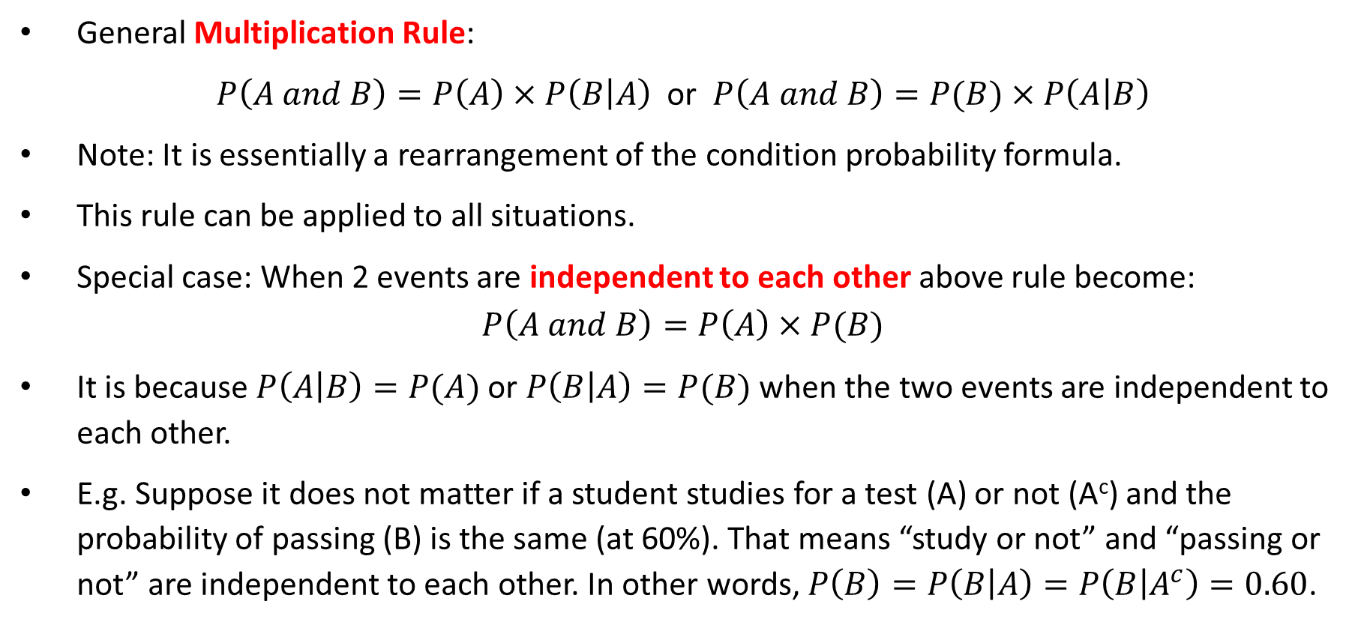
Independent Events & Multiplication Rule
General Multiplication Rule:
$P\left(A and B\right)=P\left(A\right)×P\left(B | A\right)$ or $P\left(A and B\right)=P(B)×P\left(A | B\right)$
Note: It is essentially a rearrangement of the condition probability formula.
This rule can be applied to all situations.
Special case: When 2 events are independent to each other above rule become:
$$P\left(A and B\right)=P\left(A\right)×P(B)$$
It is because $P\left(A | B\right)=P(A)$ or $P\left(B | A\right)=P(B)$ when the two events are independent to each other.
E.g. Suppose it does not matter if a student studies for a test (A) or not (A^{c}) and the probability of passing (B) is the same (at 60%). That means “study or not” and “passing or not” are independent to each other. In other words, $P\left(B\right)=P\left(B | A\right)=P\left(B | A^{c}\right)=0.60$.
Notes:
Note: The product of two probabilities is ALWAYS smaller than either one of the two probabilities.

Slide 17
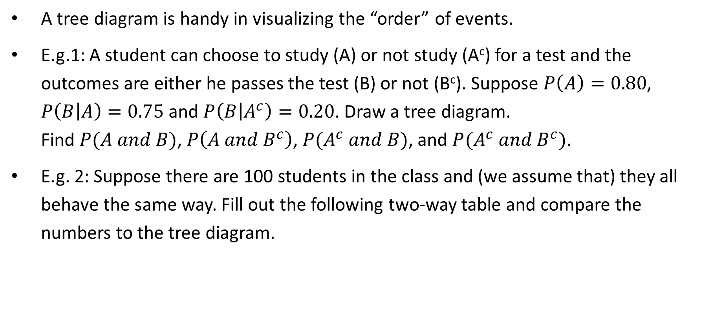
Tree Diagram
A tree diagram is handy in visualizing the “order” of events.
E.g.1: A student can choose to study (A) or not study (A^{c}) for a test and the outcomes are either he passes the test (B) or not (B^{c}). Suppose $P\left(A\right)=0.80$, $P\left(B | A\right)=0.75$ and $P\left(B | A^{c}\right)=0.20$. Draw a tree diagram. Find $P(A and B)$, $P\left(A and B^{c}\right)$, $P(A^{c} and B)$, and $P(A^{c} and B^{c})$.
E.g. 2: Suppose there are 100 students in the class and (we assume that) they all behave the same way. Fill out the following two-way table and compare the numbers to the tree diagram.
 | Study (A) | Not Study (A^{c})
Pass (B)
Not Pass (B^{c})
 |  |  | 100

Slide 18
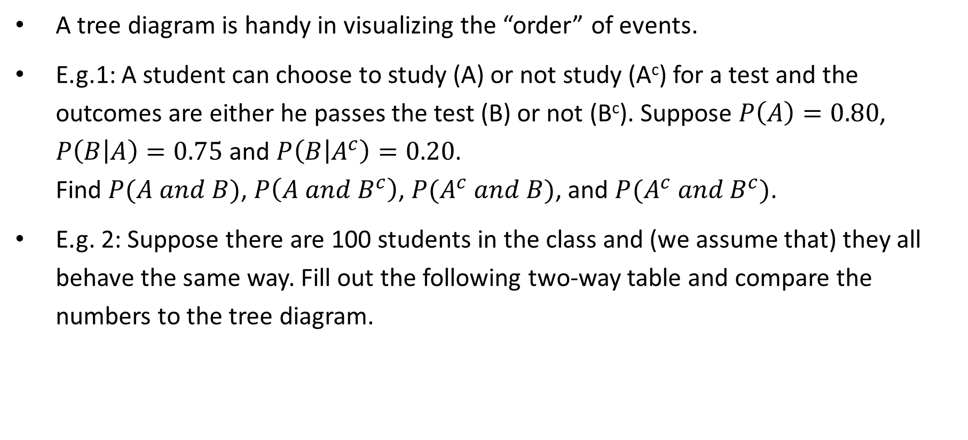
Tree Diagram - Answers
A tree diagram is handy in visualizing the “order” of events.
E.g.1: A student can choose to study (A) or not study (A^{c}) for a test and the outcomes are either he passes the test (B) or not (B^{c}). Suppose $P\left(A\right)=0.80$, $P\left(B | A\right)=0.75$ and $P\left(B | A^{c}\right)=0.20$. Find $P(A and B)$, $P\left(A and B^{c}\right)$, $P(A^{c} and B)$, and $P(A^{c} and B^{c})$.
E.g. 2: Suppose there are 100 students in the class and (we assume that) they all behave the same way. Fill out the following two-way table and compare the numbers to the tree diagram.
 | Study (A) | Not Study (A^{c})
Pass (B) | 60 | 4 | 64
Not Pass (B^{c}) | 20 | 16 | 36
 | 80 | 20 | 100
Notes:
Eg1:
P(A and B) = 0.6
P(A and Bc) = 0.20
P(Ac and B) = 0.04
P(Ac and Bc) = 0.16

Slide 19
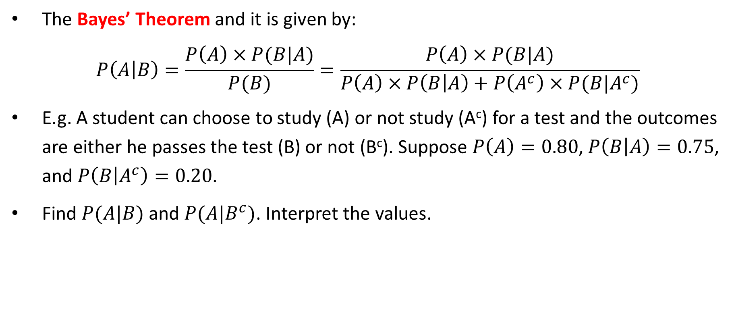
Bayes’ Theorem
The Bayes’ Theorem and it is given by:
$$P\left(A | B\right)=\frac{P\left(A\right)×P(B|A)}{P(B)}=\frac{P\left(A\right)×P(B|A)}{P\left(A\right)×P\left(B | A\right)+P\left(A^{c}\right)×P(B|A^{c})}$$
E.g. A student can choose to study (A) or not study (A^{c}) for a test and the outcomes are either he passes the test (B) or not (B^{c}). Suppose $P\left(A\right)=0.80$, $P\left(B | A\right)=0.75$, and $P\left(B | A^{c}\right)=0.20$.
Find $P(A|B)$ and $P(A|B^{c})$. Interpret the values.
Notes:
Note: The denominator of the formula above is called the Law of Total Probability
P(B) = P(A and B) + P(Ac and B) = P(A)*(B|A) + P(Ac)*P(B|Ac)
P(A|B) = 0.80*0.75/0.64 = 0.9375
Among all students who passed the test, about 94% of them had studied.
P(A|Bc) = 0.80*0.25/0.36 = 0.5556
Among all students who didn’t pass the test, about 56% of them did study.

Slide 20
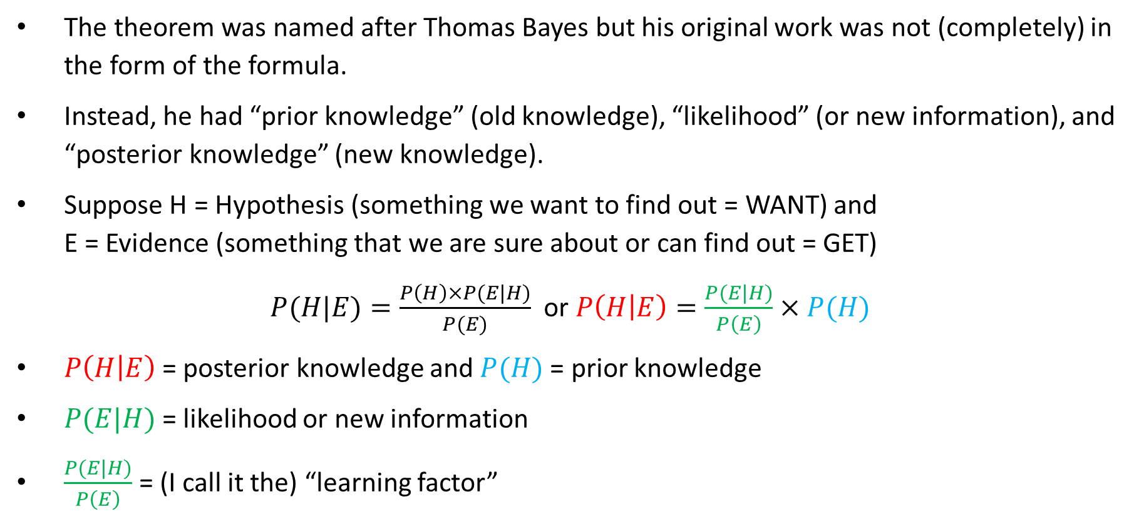
My Interpretations of Bayes’ Theorem
The theorem was named after Thomas Bayes but his original work was not (completely) in the form of the formula.
Instead, he had “prior knowledge” (old knowledge), “likelihood” (or new information), and “posterior knowledge” (new knowledge).
Suppose H = Hypothesis (something we want to find out = WANT) and E = Evidence (something that we are sure about or can find out = GET)
$P(H|E)=\frac{P\left(H\right)×P(E|H)}{P(E)}$ or $P\left(H | E\right)=\frac{P(E|H)}{P\left(E\right)}×P(H)$
$P\left(H | E\right)$= posterior knowledge and $P(H)$= prior knowledge
$P(E|H)$= likelihood or new information
$\frac{P(E|H)}{P\left(E\right)}$= (I call it the) “learning factor”
Notes:
If the learning factor is bigger than 1, you learn better because posterior > prior.
If the learning factor is less than 1, you don’t learn as well because posterior < prior.

Slide 21
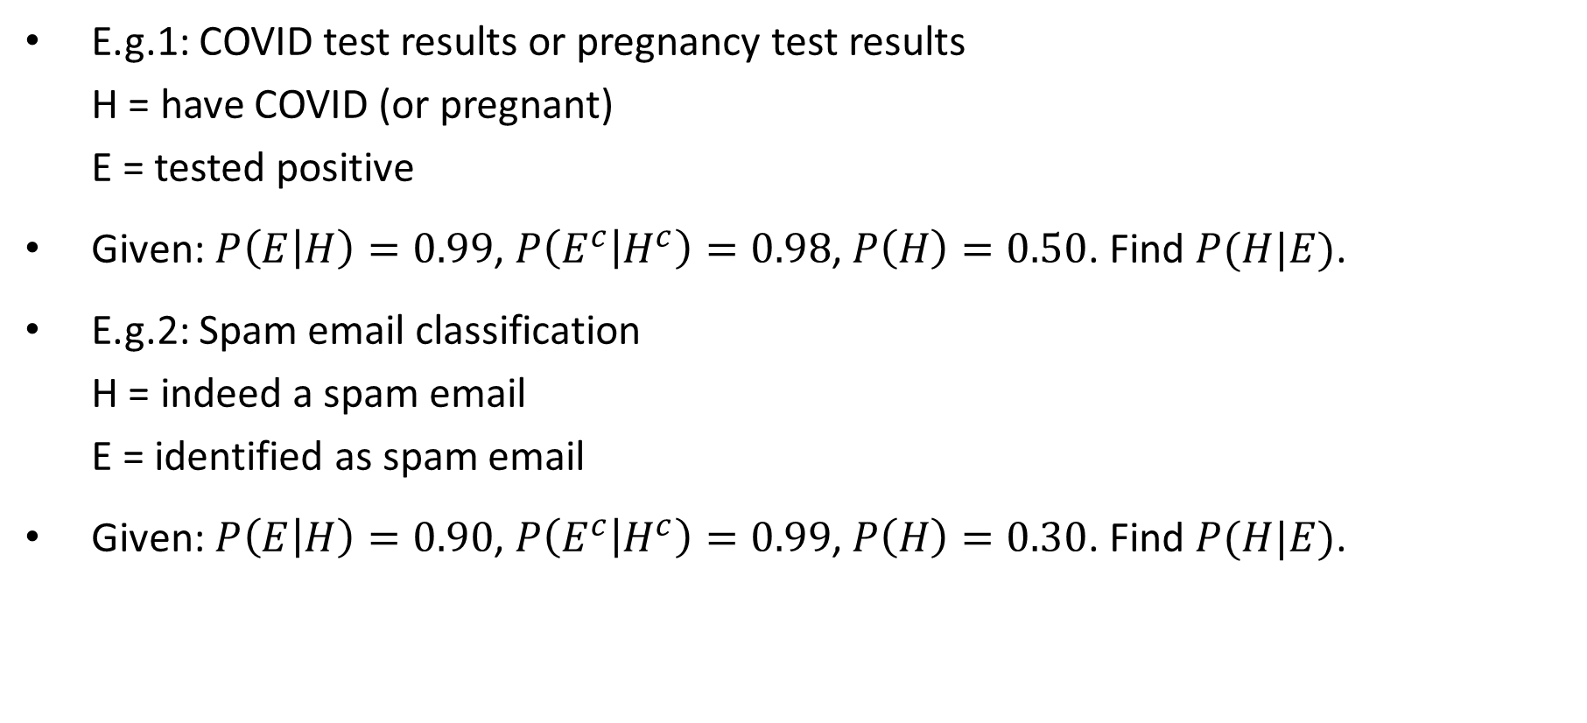
Applications of Bayes’ Theorem
E.g.1: COVID test results or pregnancy test results H = have COVID (or pregnant) E = tested positive
Given: $P\left(E | H\right)=0.99$, $P\left(E^{c} | H^{c}\right)=0.98$, $P\left(H\right)=0.50$. Find $P(H|E)$.
E.g.2: Spam email classification H = indeed a spam email E = identified as spam email
Given: $P\left(E | H\right)=0.90$, $P\left(E^{c} | H^{c}\right)=0.99$, $P\left(H\right)=0.30$. Find $P(H|E)$.

Slide 22

Any Questions?

